Slide 1
Cloud Core – Identity & Devices
Ben Stegink

Slide 2

Day Two Rundown
Timeframe | Activity | Engagement
7:30 – 8:00 | Virtual check-in
8:00 – 9:00 | Identity and Devices | Interactive Discussion
9:00 – 9:15 | Break
9:15 – 11:00 | Design Hybrid Identity Environment | Hands On: Group Work
11:00 – 12:00 | Lunch
12:00 – 12:55 | Modern Workplace Services | Interactive Discussion
12:55 – 1:00 | Break
1:00 – 2:00 | Exchange Migration | Hands On: Group Work
2:00 | Wrap Up the Day

Slide 3
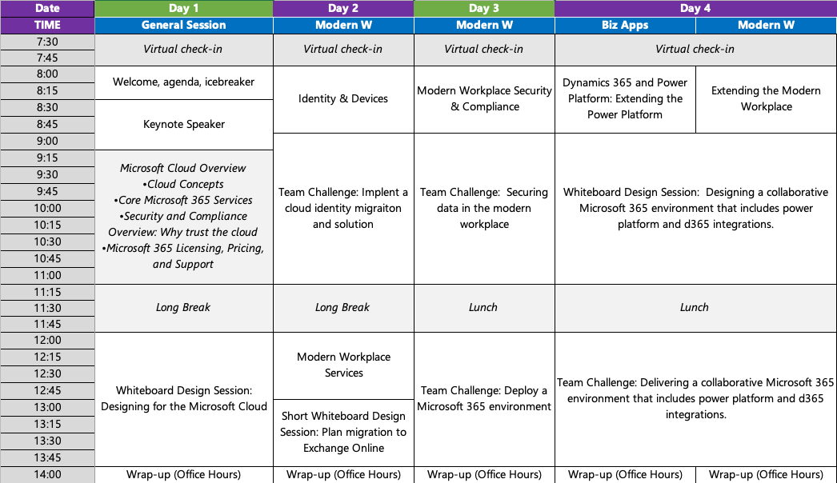

Slide 4

“We’ve seen two years’ worth of digital transformation in two months. From remote teamwork and learning, to sales and customer service, to critical cloud infrastructure and security—we are working alongside customers every day to help them adapt and stay open for business in a world of remote everything.” – Satya Nadella

Slide 5
Identity – the foundation of everything

Slide 6
The threats are real, global, and target all of us
Aug 2020 - 9 M
High risk sign-in attempts
5.8B
Attacker driving sign in attempts

Slide 7
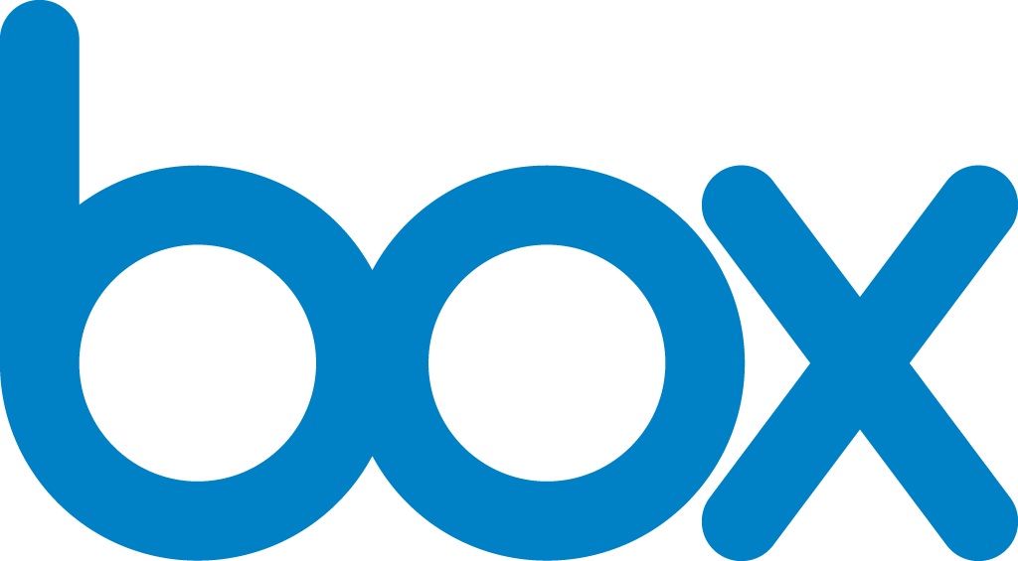



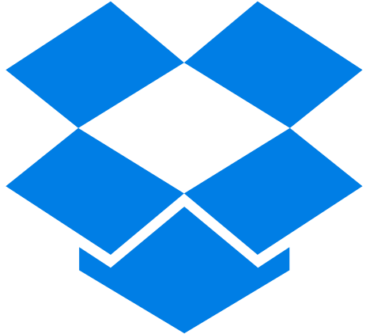

Manage and secure with identity as the control plane
Cloud Apps
Partners & Customers
Employees
Identity
On-premises apps
Devices

Slide 8
Active Directory

Slide 9
What is Active Directory?
Microsoft Active Directory Domain Services (AD DS) are the foundation for distributed networks built on Windows 2000 - 2019 operating systems that use domain controllers.
Domain controllers like Active Directory Domain Services provide secure, structured, hierarchical data storage for objects in a network such as users, computers, printers, and services.
Active Directory Domain Services provide support for locating and working with these objects.
Active Directory is typically deployed in on-premises environments but can also be deployed in cloud-based environments to provide domain services to Virtual Machines.

Slide 10
What about Azure AD Domain Services?
Azure AD Domain Services provides a cloud-based option to use AD DS for lightweight Azure VM configuration control and a way to meet on-premises identity requirements for network application development and testing.
Azure AD Domain Services is not meant to lift and shift your on-premises AD DS infrastructure to Azure VMs managed by Azure AD Domain Services.
Instead, the Azure VMs in managed domains should be used to support the development, testing, and movement of on-premises applications that require AD DS authentication methods to the cloud.
Azure AD Domain Services is NOT Azure AD

Slide 11
Azure Active Directory (AAD)

Slide 12
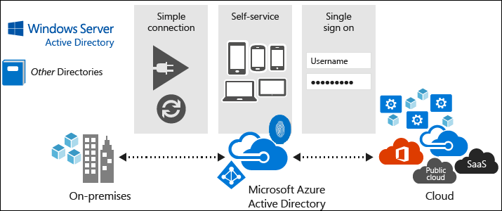
What is Azure Active Directory?
Azure Active Directory (Azure AD or AAD) is Microsoft’s multi-tenant, cloud-based directory, and identity and access management service
Azure AD combines into a single solution:
core directory services
application access management
identity protection
Offers a standards-based platform that helps deliver access control to apps, based on centralized policy and rules.
Can’t yet fully replace Active Directory Domain Services

Slide 13
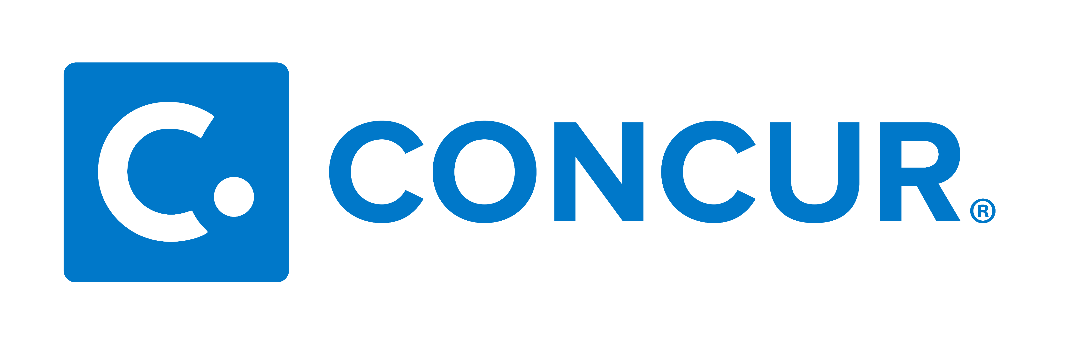
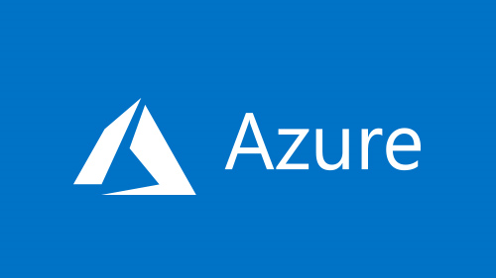



Managing cloud applications at scale with Azure AD
Provisioning
Authentication
Every Office 365 & Microsoft Azure customer uses Azure AD
Simple click-through onboarding for pre-integrated applications
Microsoft Azure
Active Directory
HR Application
Identity Management solution
Directory Synchronization
Federation
provider
1.1B
634 K
Windows Server
Active Directory
identities
3rd party apps in Azure AD
Other User Directories
Other Applications
On-premises

Slide 14
What is Single Sign On (SSO)?
Users don’t have to sign in more than once
convenient for users
maximize usage of your app
Types of single sign on
silent (no UI)
interactive (tap your account name)

Slide 15
Device states in Azure AD
Azure
AD
Azure
AD
Azure
AD
AD
AD
AD
Hybrid Azure AD joined
Azure AD joined
Azure AD registered

Slide 16
Connecting AD and Azure AD

Slide 17
Consider how an on-premises organization adopts cloud services
Provisioning
Unmanaged
Authentication
X
HR Application
Identity Management solution
Directory Synchronization
Federation
provider
Windows Server
Active Directory
Other User Directories
Other Applications
On-premises

Slide 18

Azure AD enables managing cloud applications at scale without sacrificing the on-premises identity
Provisioning
Authentication
Every Office 365 & Microsoft Azure customer uses Azure AD
Microsoft Azure
Active Directory
HR Application
Identity Management solution
Directory Synchronization
Federation
provider
Windows Server
Active Directory
Other User Directories
Other Applications
On-premises

Slide 19

What is Azure AD Connect?
Azure AD Connect is the Microsoft tool designed support hybrid identity. This allows for a common identity for users of Office 365, Azure, and SaaS applications integrated with Azure AD.
Azure AD Connect provides:
Synchronization
AD FS and federation integration
Pass-thru Authentication
Health monitoring
Azure AD Connect replaces older versions of identity integration tools such as DirSync and Azure AD Sync.
Notes:
It provides the following features:
Synchronization - This component is responsible for creating users, groups, and other objects. It is also responsible for making sure identity information for your on-premises users and groups is matching the cloud. It is responsible for synchronizing password hashes with Azure AD.
AD FS and federation integration - Federation is an optional part of Azure AD Connect and can be used to configure a hybrid environment using an on-premises AD FS infrastructure. It also provides AD FS management capabilities such as certificate renew and additional AD FS server deployments.
Pass-through Authentication - Another optional component that allows users to use the same password on-premises and in the cloud, but doesn't require the additional infrastructure of a federated environment
Health Monitoring - Azure AD Connect Health can provide robust monitoring and provide a central location in the Azure portal to view this activity.

Slide 20
What is Azure AD Connect cloud provisioning?
Azure AD Connect cloud provisioning is a new Microsoft agent designed to meet and accomplish your hybrid identity goals for synchronization of users, groups and contacts to Azure AD. It can be used alongside Azure AD Connect sync.
Azure AD Connect cloud provisioning provides:
Synchronizing from a multi-forest disconnect AD forest environment
Simplified installation with light-weight provisioning agents
Multiple provisioning agents to simply high availability
Notes:
It provides the following features:
Synchronization - This component is responsible for creating users, groups, and other objects. It is also responsible for making sure identity information for your on-premises users and groups is matching the cloud. It is responsible for synchronizing password hashes with Azure AD.
AD FS and federation integration - Federation is an optional part of Azure AD Connect and can be used to configure a hybrid environment using an on-premises AD FS infrastructure. It also provides AD FS management capabilities such as certificate renew and additional AD FS server deployments.
Pass-through Authentication - Another optional component that allows users to use the same password on-premises and in the cloud, but doesn't require the additional infrastructure of a federated environment
Health Monitoring - Azure AD Connect Health can provide robust monitoring and provide a central location in the Azure portal to view this activity.

Slide 21
Azure AD Connect vs. Azure AD Connect cloud provisioning
Feature | Azure AD Connect sync | Azure AD Connect cloud provisioning
Connect to multiple disconnected on-premises AD forests |  | x
Lightweight agent installation model |  | x
Multiple active agents for HA |  | x
Support for devices objects | x
Connect to LDAP directors | x
Sync customer defined AD attributes
Pass-through authentication | x
Object attribute filter | x
Support for writeback (pwd, device groups) | x
Exchange Hybrid writeback | x
50,000+ objects | x
Azure AD DS support | x
Allow advanced customization for attribute flows | x
Notes:
It provides the following features:
Synchronization - This component is responsible for creating users, groups, and other objects. It is also responsible for making sure identity information for your on-premises users and groups is matching the cloud. It is responsible for synchronizing password hashes with Azure AD.
AD FS and federation integration - Federation is an optional part of Azure AD Connect and can be used to configure a hybrid environment using an on-premises AD FS infrastructure. It also provides AD FS management capabilities such as certificate renew and additional AD FS server deployments.
Pass-through Authentication - Another optional component that allows users to use the same password on-premises and in the cloud, but doesn't require the additional infrastructure of a federated environment
Health Monitoring - Azure AD Connect Health can provide robust monitoring and provide a central location in the Azure portal to view this activity.

Slide 22
Choosing the right sign-in approach
Password hash
synchronization (PHS)
Pass- through
Authentication (PTA)
Active Directory
Federation Service (AD FS)
Authentication in cloud
Password hash is synced to Azure
Username + Password
WIA with Seamless SSO
Authentication in cloud + on-premises agent
Username + Password
WIA with Seamless SSO
On-premises authentication
Username + Password, WIA, samAccountName, Certificate, Smart-Card

Slide 23
Azure AD Password Protection
Power of Azure – in cloud and on-premises
Powered by Azure
Intelligence from monitoring billions of authentication attempts every day
Custom list
Define custom list of weak strings for your organization
Protect users on-premises
Simple deployment on-premises to leverage the Azure logic and ensure stronger passwords

Slide 24
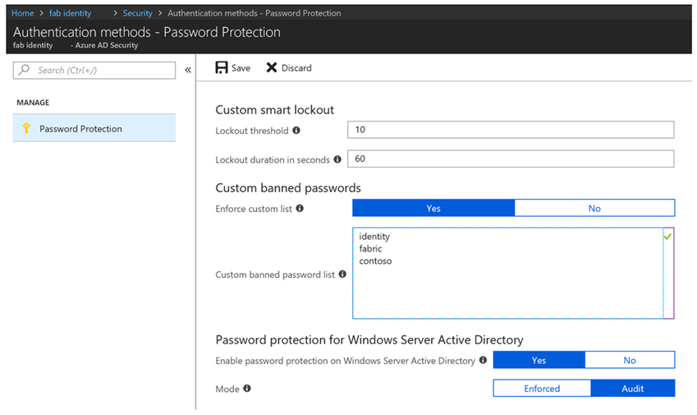
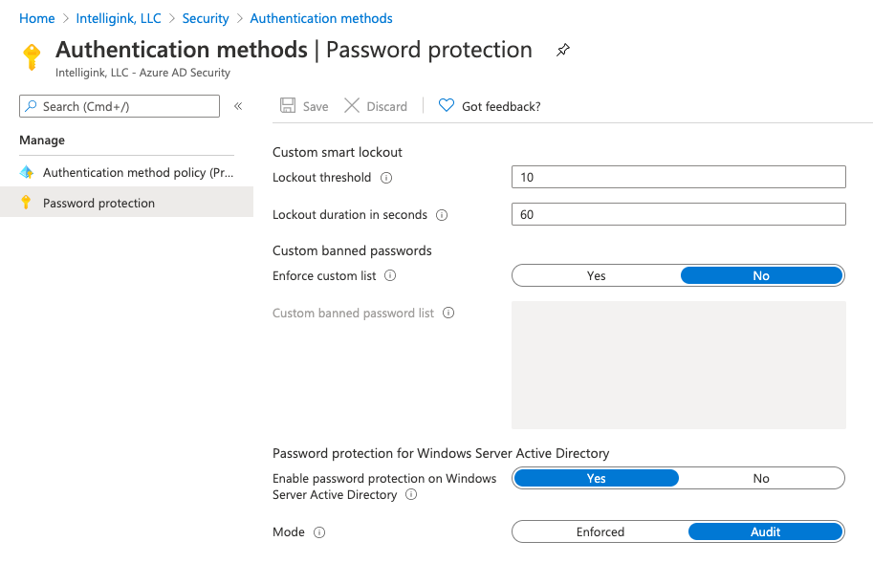
Azure AD Password Protection
Cloud intelligence to ensure strong passwords
Dynamic banning of passwords based on known bad patterns and those you define.
Built for hybrid environments.
Built for secure no-internet zone domain controllers
Unified admin experience for on-premises and cloud.
Support for multi-forest environment
High availability architecture

Slide 25
Passwords are expensive and insecure
Password reuse across multiple accounts
Passwords are the weak link
Data breaches are expensive
Passwords generate tons of support calls
73%
of passwords are duplicates
81%
of breaches leveraged passwords
$3.86
million, the average total cost of a data breach
#1 cost
for IT departments is forgotten passwords
Notes:
Passwords are complex.
We all have a lot of them.
We sometimes give easy to remember passwords which puts us at risk of security breeches.

Slide 26
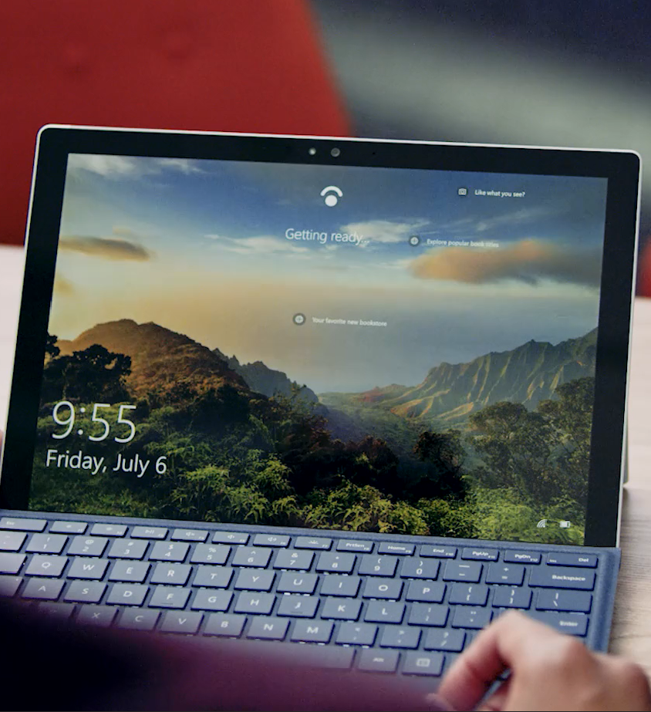
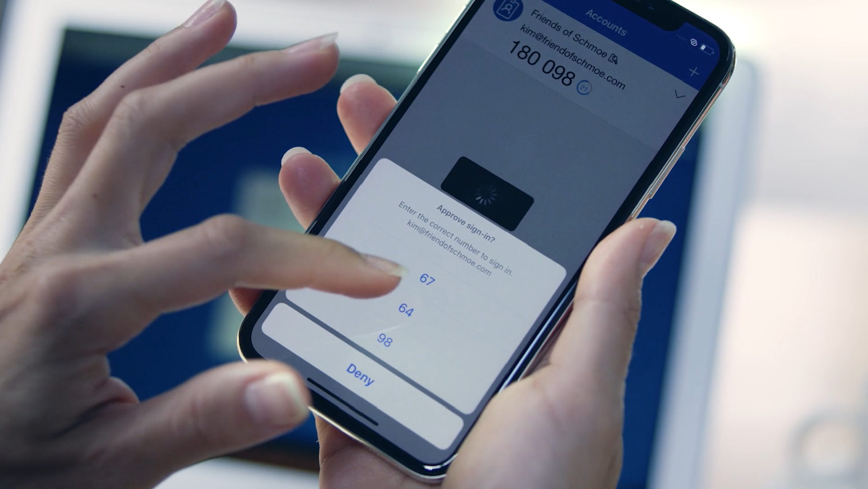

Big picture: Getting to a world without passwords
High security, convenient methods of strong authentication
Windows Hello
Microsoft Authenticator
FIDO2 Security Keys

Slide 27
Federated Identity (ADFS)

Slide 28
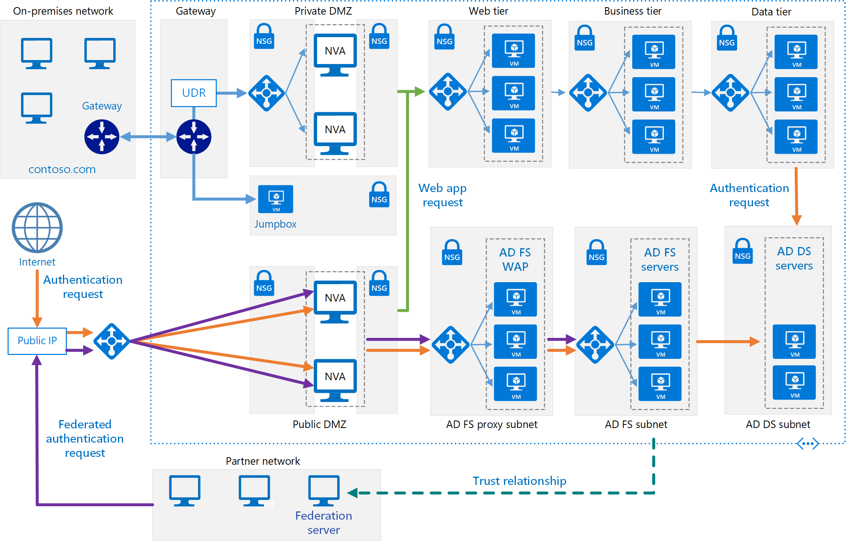
What is Active Directory Federation Services?
Active Directory Federation Services (AD FS), a software component developed by Microsoft, can run on Windows Server operating systems to provide users with single sign-on access to systems and applications located across organizational boundaries.
https://en.wikipedia.org/wiki/Active_Directory_Federation_Services

Slide 29
One more time?
AD FS is an Security Token Service (STS) that builds, signs and issues security tokens according to specific protocols that support identity federation.
Azure AD is a complete Identity and Access Management (IAM) Solution

Slide 30
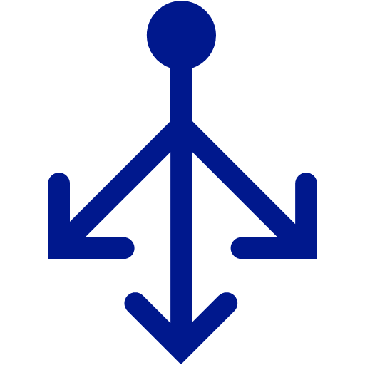
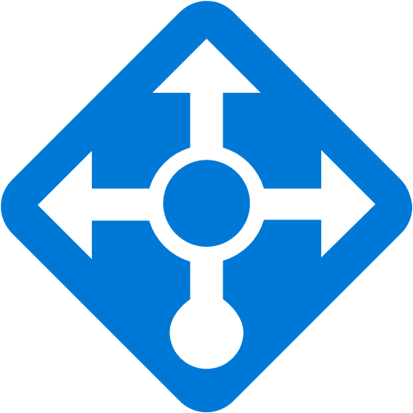

AD FS in Azure
VPN / Express Route
On-premises
Azure
AD FS + WAP
AD FS + WAP
AD FS + WAP
On-premises
AD FS Infrastructure
Azure Traffic Manager
AD FS Infrastructure
https://aka.ms/AdfsInAzure
Notes:
WAP = Web Application Proxy

Slide 31
Surface

Slide 32


Slide 33




Surface devices for every scenario
Light and Mobile
Mobile and High Performance
Creatives in an Office
Conference Room Collaboration

Slide 34
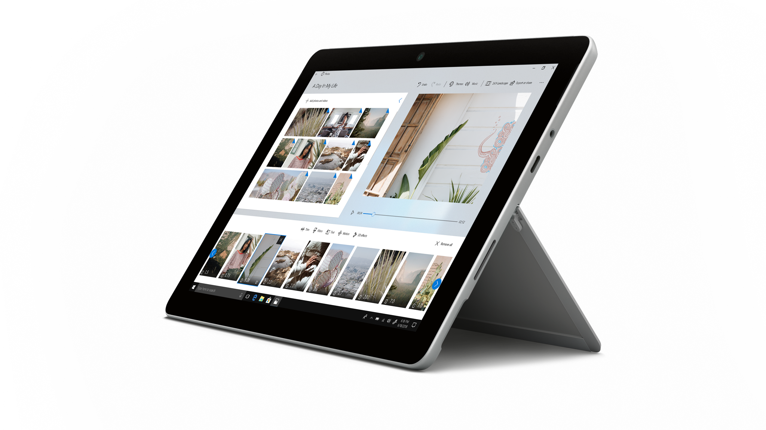
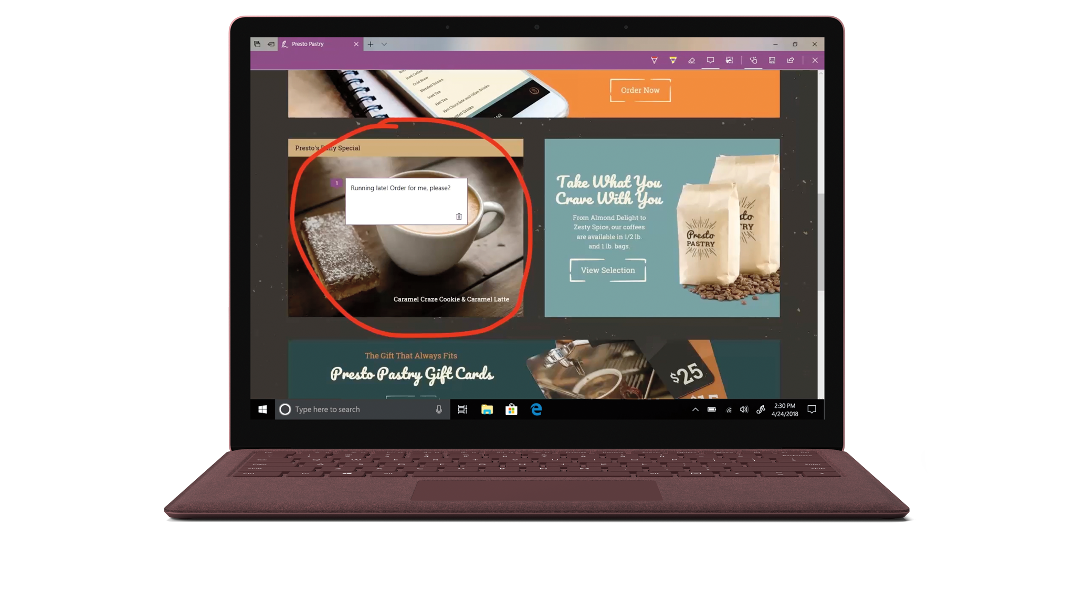
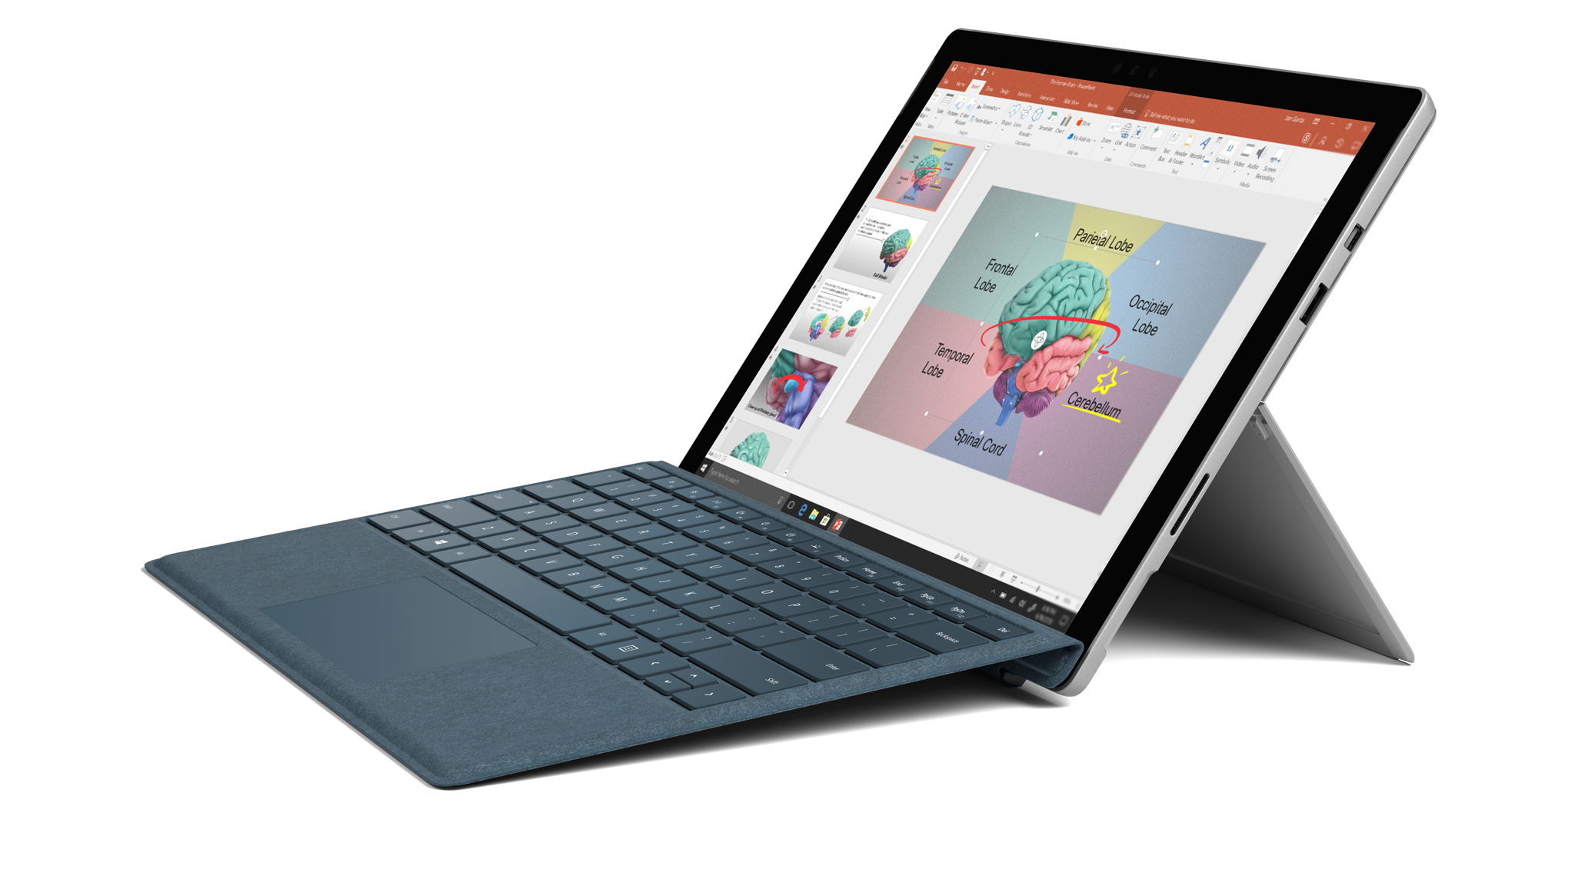
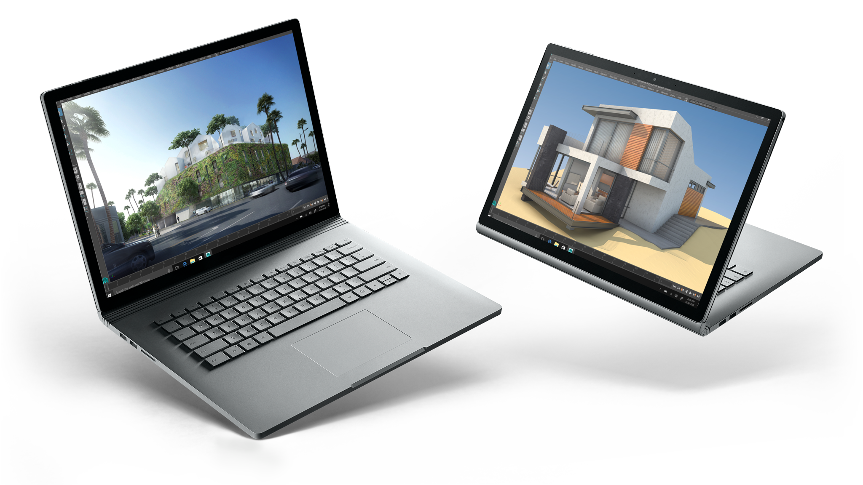
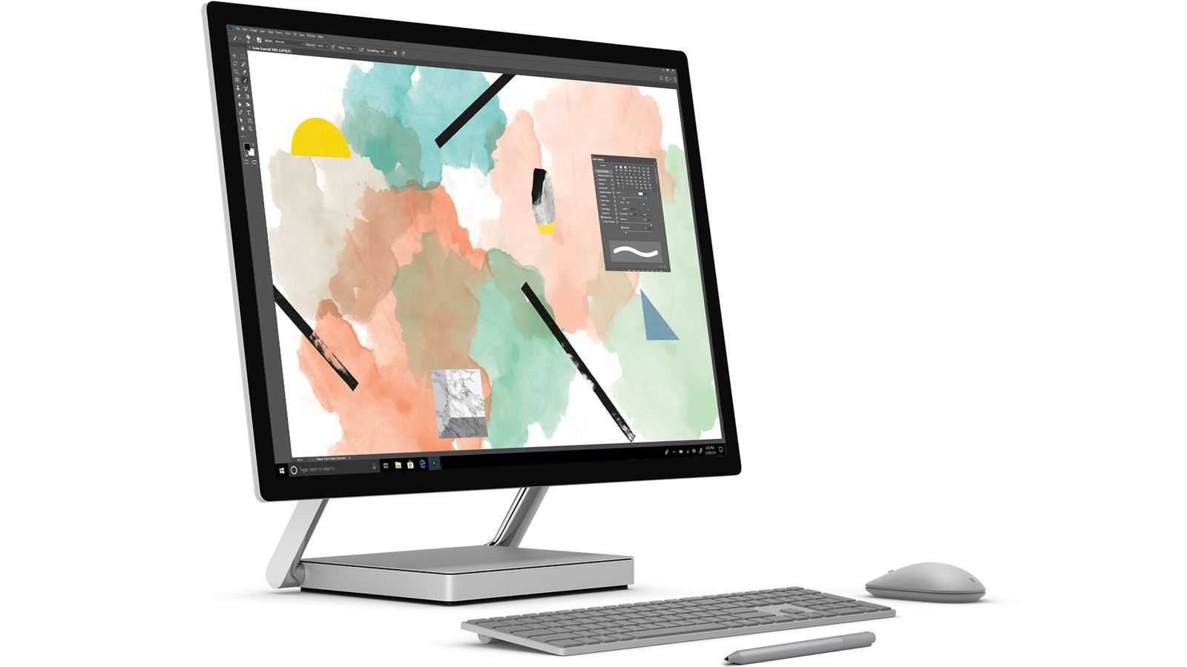
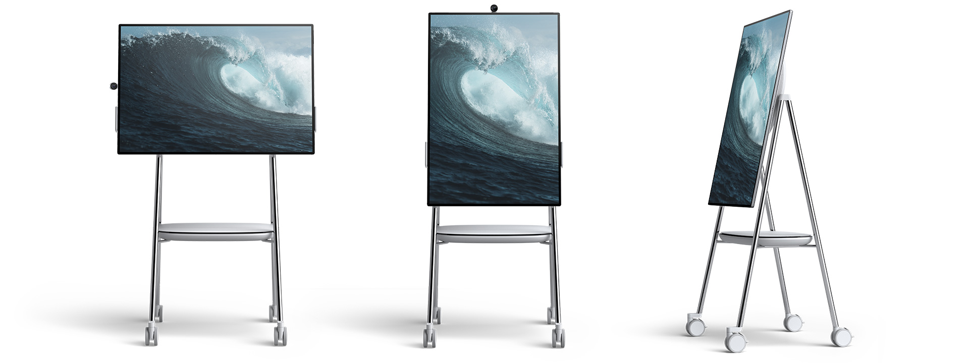
Surface Device Family
Surface Go
Surface Laptop
Surface Pro
Surface Book
Surface Studio
Surface Hub
Surface Duo

Slide 35
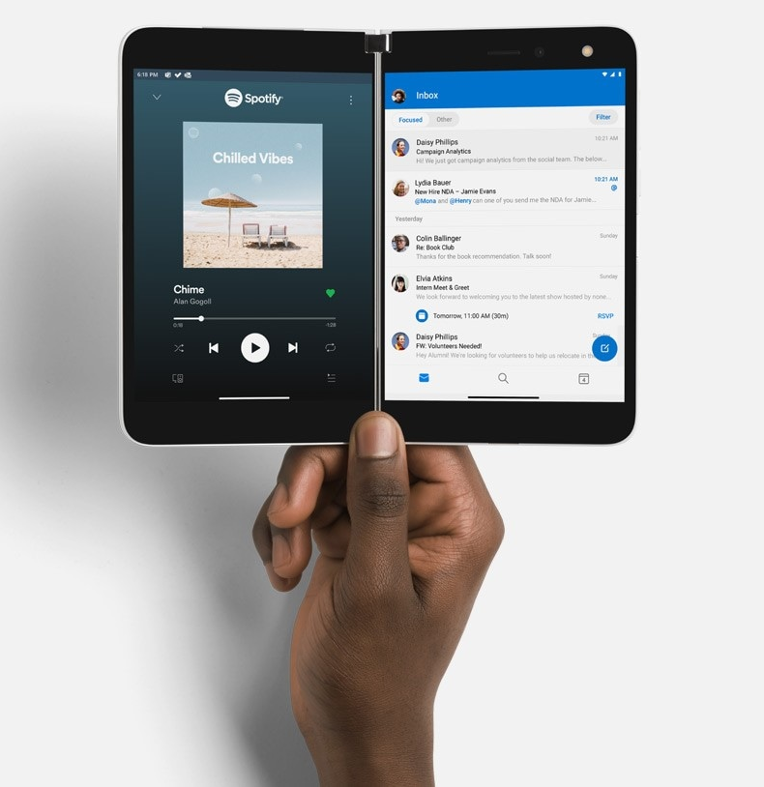
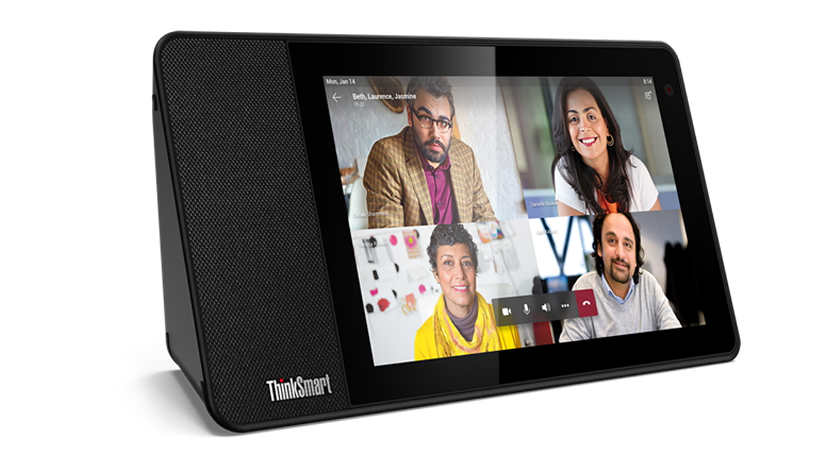
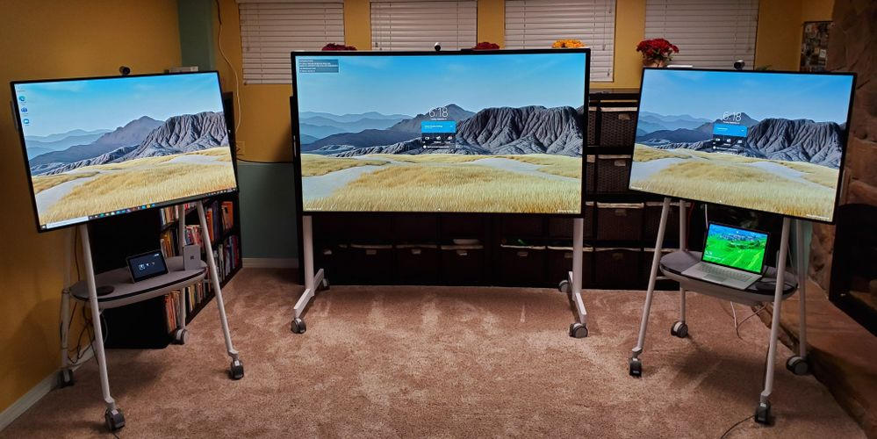
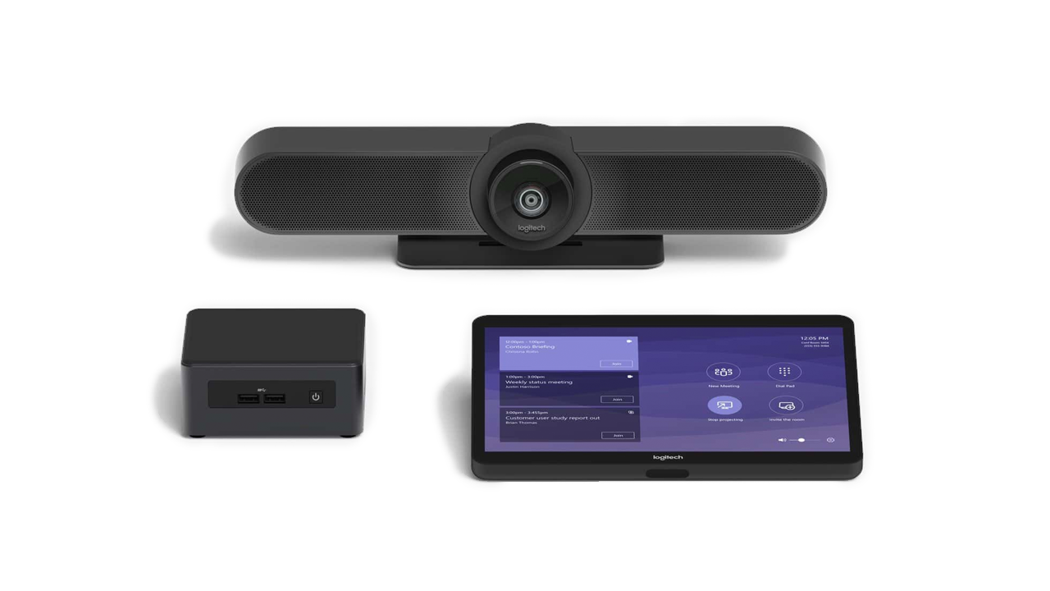
New Devices!
85” Surface Hub
Teams Devices
Surface Duo & Neo

Slide 36
Desktop Management

Slide 37
Traditional Windows deployment // The old way
OFFICE & APPS
DRIVERS
POLICIES
SETTINGS
Build a custom image, gathering everything else that’s necessary to deploy
Deploy image to a new computer, overwriting what was originally on it
Time means money, making this an expensive proposition

Slide 38
Modern Windows deployment // The new way
Un-box and turn on off-the-shelf Windows PC
Transform with minimal user interaction
Device is ready for productive use

Slide 39
Windows Autopilot overview
Device IDs
Windows Autopilot
Autopilot profile sync
Intune
Device sync
Configure Windows Autopilot profile
Self-service deploy
IT Admin
IT Admin
Hardware Vendor
Ship
Deliver direct to Employee
Employee unboxes device, self-deploys

Slide 40
Auto-Pilot

Slide 41
Windows Autopilot Scenarios
AVAILABLE
AVAILABLE
PUBLIC PREVIEW
PUBLIC PREVIEW
PREVIEW
PREVIEW
User-driven mode
Windows Autopilot reset - local
Windows Autopilot reset - remote
Self-deploying mode
Hybrid Azure AD join
Existing devices
Windows 10 1703 and above
Join device to AAD, enroll in Intune/MDM
Windows 10 1709 and above
Join device to AAD, enroll in Intune/MDM
Windows 10 Insider Preview Build 17672 and later
Execute a device reset via Intune and maintain AAD join and MDM enrollment
Windows 10 Insider Preview Build 17672 and later
No need to provide credentials, automatically joins AAD
Windows 10 1809 and above
Join device to AD, enroll in Intune/MDM
Windows 10 1809 and above
Windows 7 to Windows 10
ConfigMgr task sequence, followed by Windows Autopilot user-driven mode
Once enrolled, easy to bootstrap ConfigMgr agent from Microsoft Intune over CMG

Slide 42
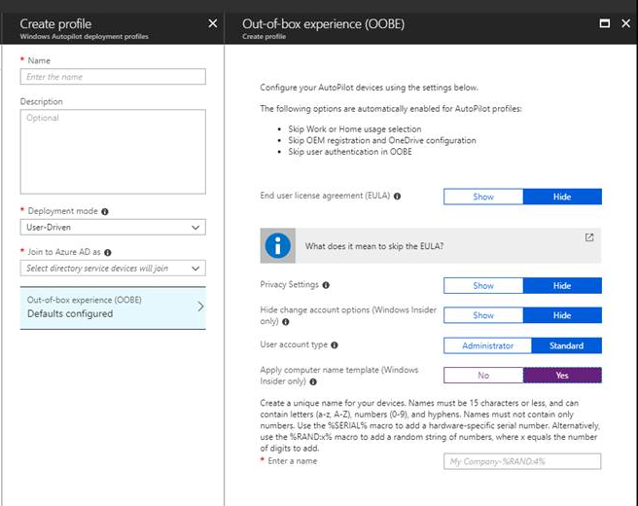
Creating an Autopilot profile
Configure important details:
Deployment mode
Specific settings required for the deployment mode
New! BitLocker encryption even for non-admin users (requires Windows 10 1809)
Out-of-box experience (OOBE) settings
New! Hide change account options (requires Windows 10 1809)
New! Device naming pattern, supporting variable substitution (requires Windows 10 1809):
%SERIAL%
%RAND:x% (where X is the number of digits)
Notes:
“Text…”
Key points to land
Text
Text
Text

Slide 43
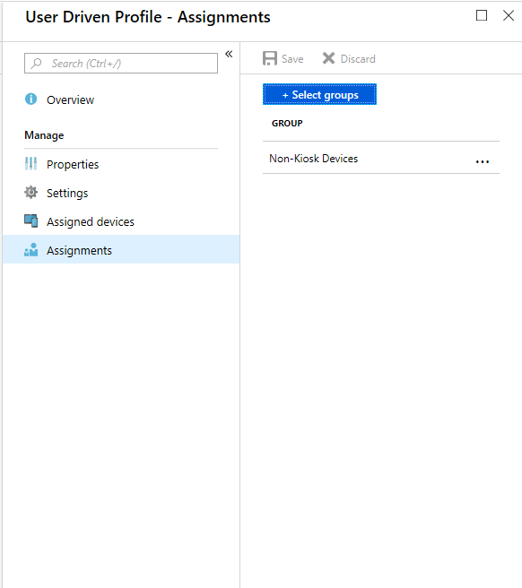
Assigning an Autopilot profile Automated using groups
If you have existing Windows 10 devices:
An Azure AD device object is automatically created for each imported Autopilot device
Create one or more Azure AD groups
Assign an Autopilot profile to the Azure AD group
Intune will automatically assign the profile to all members of the assigned group
Options for grouping:
Dynamic group with all Autopilot devices
Dynamic group based on purchase order ID
Dynamic group based on device tag (orderID)
Manual
Notes:
“Text…”
Key points to land
Text
Text
Text

Slide 44
Windows Virtual Desktop (WVD)

